Slide 1
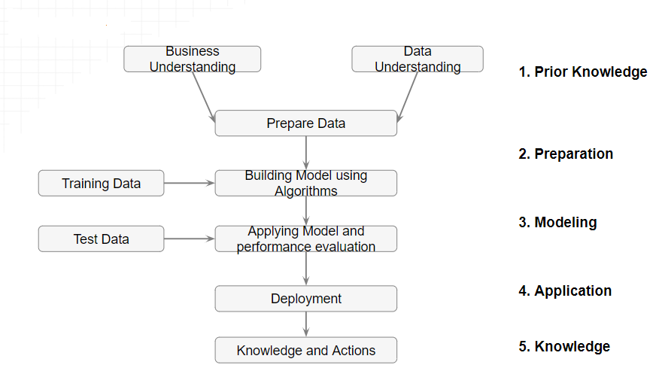
Introduction to Machine Learning

Slide 2
Introduction to Machine Learning
Definition of Machine Learning (ML)
Differences between AI, ML, and Deep Learning
Real-world applications of ML (e.g., image recognition, natural language processing, recommendation systems)

Slide 3
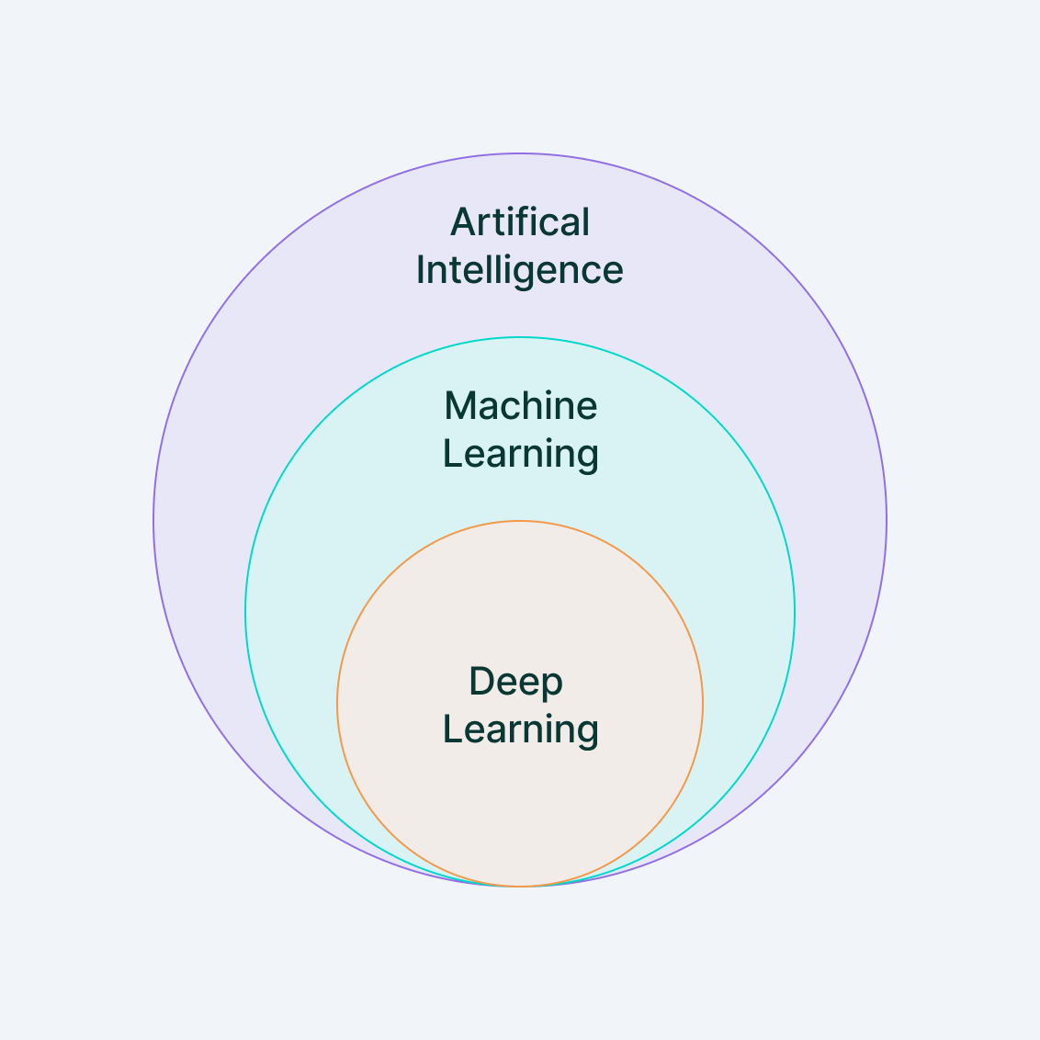
Machine Learning
Machine Learning (ML) is a branch of artificial intelligence (AI) that focuses on building systems that can learn from data, identify patterns, and make decisions with minimal human intervention.
In essence, machine learning allows computers to "learn" from past experiences (data) and improve their performance over time without being explicitly programmed for every possible scenario.
https://www.v7labs.com/blog/machine-learning-guide

Slide 4
Machine Learning: Applications
Image Recognition:
Facial Recognition: Used in smartphones, social media platforms (e.g., Facebook photo tagging), and security systems. ML algorithms can detect and recognize human faces in images or videos.
Medical Imaging: ML is used in analyzing X-rays, MRIs, and CT scans to identify abnormalities such as tumors, fractures, or other diseases.
Object Detection: Used in autonomous vehicles, retail (e.g., Amazon Go stores), and security surveillance systems.

Slide 5
Machine Learning: Applications
Speech and Voice Recognition:
Virtual Assistants: ML powers virtual assistants like Siri, Alexa, and Google Assistant, enabling them to recognize and respond to voice commands.
Speech-to-Text: Applications like Google Voice Typing and automated transcription services convert spoken words into written text.
Voice Biometrics: Used in security systems for identifying individuals based on their voice.

Slide 6
Machine Learning: Applications
Natural Language Processing (NLP):
Chatbots and Customer Support: ML-driven chatbots can understand and respond to customer queries, improving customer service for companies like banks, e-commerce platforms, and service providers.
Language Translation: Google Translate and other language translation apps use ML models to translate text and speech between different languages.
Sentiment Analysis: Businesses use ML to analyze customer reviews, social media posts, and other text data to determine public sentiment or opinions about products or services.

Slide 7
Machine Learning: Applications
Recommendation Systems:
E-commerce: Platforms like Amazon and Alibaba use ML to recommend products based on a user’s browsing history, purchase behavior, and preferences.
Streaming Services: Netflix, Spotify, and YouTube recommend movies, music, and videos by analyzing user interactions, viewing history, and preferences.
Social Media: Facebook, Twitter, and Instagram use recommendation algorithms to suggest friends, posts, or content that align with a user’s interests.

Slide 8
Machine Learning: Applications
Fraud Detection:
Banking and Finance: ML algorithms analyze transaction patterns to detect fraudulent activities, such as credit card fraud, money laundering, or account takeovers.
Insurance: Insurers use ML to detect fraudulent insurance claims by spotting unusual patterns or behaviors in claim submissions.
Autonomous Vehicles:
Self-Driving Cars: Companies like Tesla, Waymo, and Uber use ML to help autonomous vehicles interpret their surroundings (e.g., detecting pedestrians, road signs, and other cars), make driving decisions, and navigate safely.
Drone Navigation: ML is used in drones for route planning, object detection, and collision avoidance.

Slide 9
Machine Learning: Applications
Healthcare and Medical Diagnosis:
Disease Prediction: ML models help predict the likelihood of diseases such as diabetes, heart disease, or cancer by analyzing patient data.
Personalized Medicine: Machine learning enables the development of personalized treatment plans based on a patient's genetics, medical history, and current health data.
Drug Discovery: ML accelerates the process of discovering new drugs by analyzing data from clinical trials and identifying potential drug candidates.
More….
Finance and Stock Market Analysis
Marketing and Advertising
Supply Chain Optimization
Gaming, Robotics, Cybersecurity
Personalization
Energy Efficiency

Slide 10
Types of Machine Learning
Supervised Learning
Unsupervised Learning

Slide 11
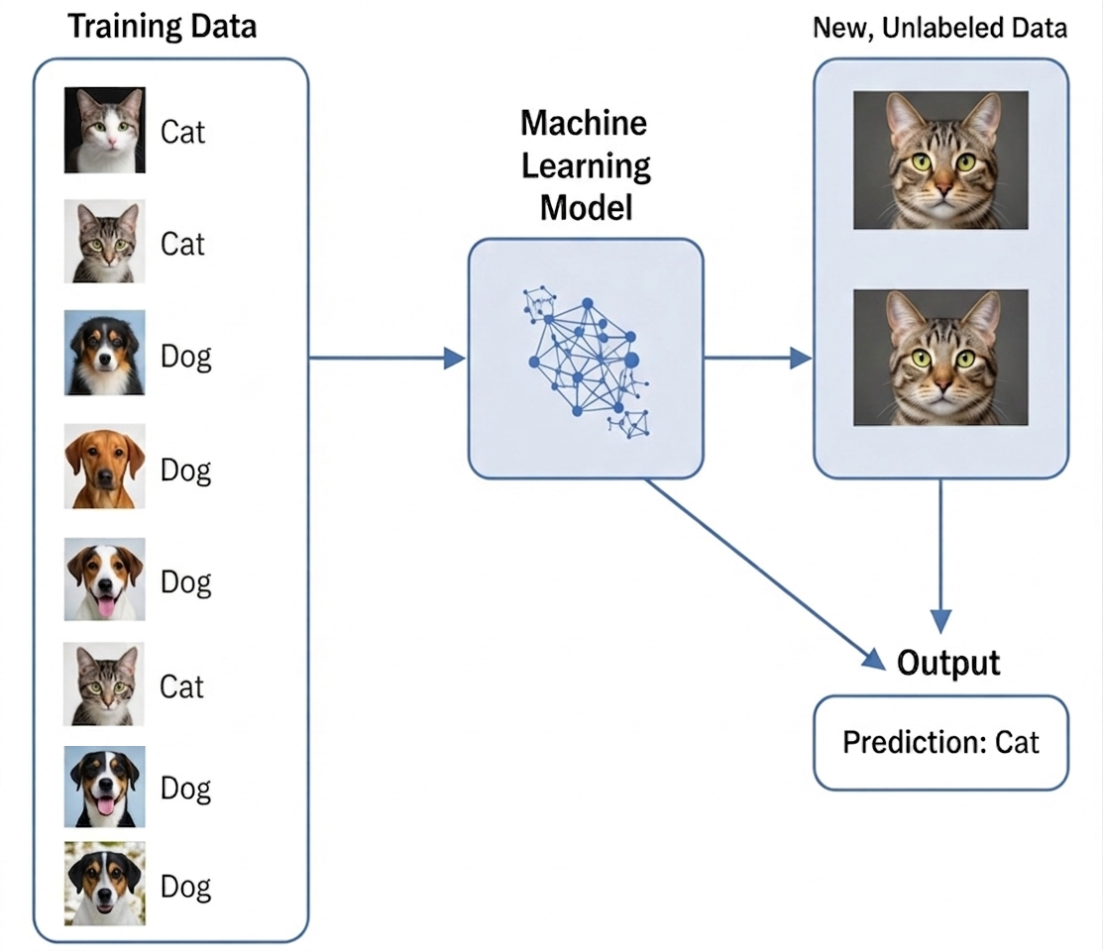
Types of Machine Learning
Supervised Learning
In supervised learning, the model is trained on labeled data, meaning that each training example has both input data and a corresponding correct output (label).
The goal is for the model to learn the mapping from inputs to outputs so that it can predict the output for new, unseen data.

Slide 12
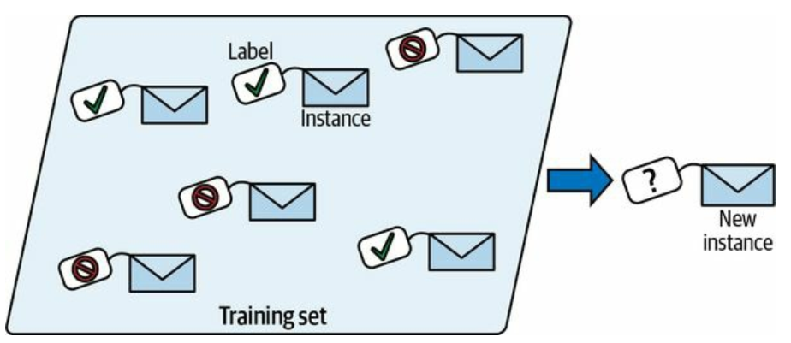
Types of Machine Learning
Supervised Learning
In supervised learning, the model is trained on labeled data, meaning that each training example has both input data and a corresponding correct output (label).
The goal is for the model to learn the mapping from inputs to outputs so that it can predict the output for new, unseen data.
Example: Spam detection in emails, where the model is trained on labeled emails (spam or not spam).

Slide 13
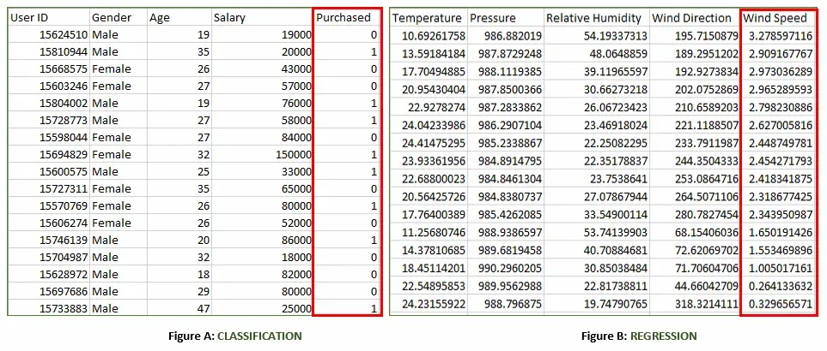
Types of Machine Learning
Supervised Learning: Classification
https://www.geeksforgeeks.org/machine-learning/supervised-machine-learning/

Slide 14
Types of Machine Learning
Supervised Learning: Regression
https://www.geeksforgeeks.org/machine-learning/supervised-machine-learning/

Slide 15
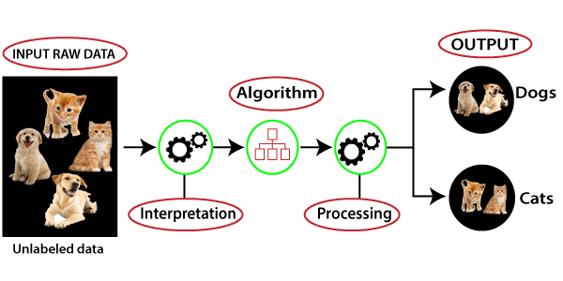
Types of Machine Learning
Unsupervised Learning
In unsupervised learning, the model is given data without explicit labels. It tries to learn the structure of the data and discover hidden patterns or groupings.
Example: Customer segmentation, where the goal is to group customers based on purchasing behavior without knowing any predefined categories.
https://www.javatpoint.com/unsupervised-machine-learning

Slide 16
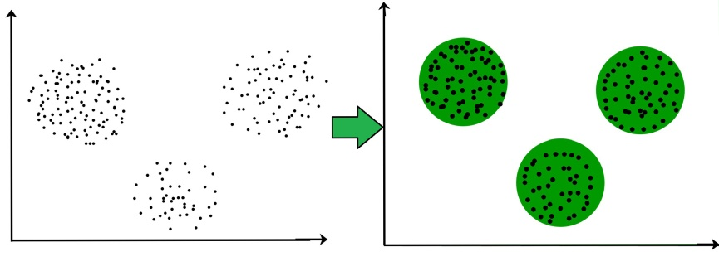
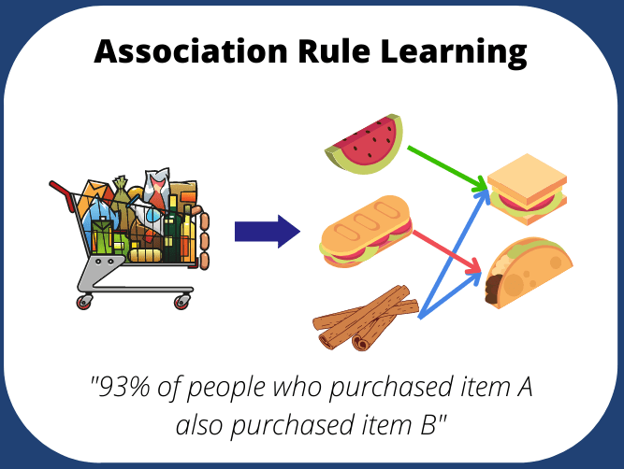
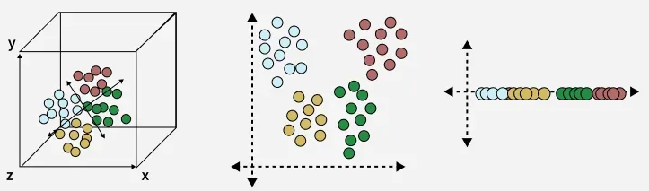
Types of Machine Learning
Unsupervised Learning
Works with unlabeled data
Discovers hidden patterns
Used for exploration and pattern detection
No supervision (no correct answers provided)
Main Types of Unsupervised Learning
Clustering
Association Rule Learning
Dimensionality Reduction
https://www.geeksforgeeks.org/machine-learning/clustering-in-machine-learning/
https://medium.com/@sahinn.muhammed.alii/association-rule-learning-with-apriori-algorithm-649ba26b93b7
https://www.geeksforgeeks.org/data-science/dimensionality-reduction-techniques/

Slide 17
Key Concepts in Machine Learning
Data and Features: input data, features, labels
Model and Algorithm: what is a model, common ML algorithms
Training and Testing: data splitting (train-test-validation sets)
Loss Function: error measurement, cost function
Optimization: gradient descent basics

Slide 18
Learning Process
How a model learns: data → algorithm → model
Model evaluation metrics: accuracy, precision, recall, F1 score
Overfitting and underfitting: bias-variance tradeoff

Slide 19
Fundamental Algorithms Overview
Linear Regression
Logistic Regression
Decision Trees
k-Nearest Neighbors (k-NN)
Briefly introduce more advanced methods (e.g., Neural Networks, Support Vector Machines)

Slide 20
Challenges in Machine Learning
Data quality and quantity
Feature engineering and selection
Interpretability and explainability of models
Scalability and performance

